Slide 1
Principles of AI
By
Dr. John A

Slide 2
Syllabus
Knowledge Representation, Problem Solving, Searching and its Strategies, Heuristic Search, AI Project Cycle, Problem Scoping, Data Acquisition, Data Exploration, Modeling
Outcome: Understand the principles of AI and its life cycle

Slide 3
Introduction to Knowledge Representation
An intelligent agent needs knowledge about the real world for taking decisions and reasoning to act efficiently.
Knowledge-based agents are those agents who have the capability of maintaining an internal state of knowledge, reason over that knowledge, update their knowledge after observations and take actions. These agents can represent the world with some formal representation and act intelligently.
Knowledge-based agents are composed of two main parts:
  Knowledge-base and
  Inference system.

Slide 4
Introduction to Knowledge Representation
A knowledge-based agent must able to do the following:
  An agent should be able to represent states, actions, etc.
  An agent Should be able to incorporate new percepts
  An agent can update the internal representation of the world
  An agent can deduce the internal representation of the world
  An agent can deduce appropriate actions

Slide 5
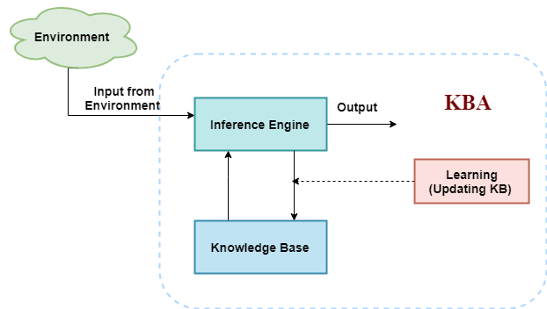
Introduction to Knowledge Representation

Slide 6
Introduction to Knowledge Representation
Knowledge base: Knowledge-base is a central component of a knowledge-based agent, it is also known as KB. It is a collection of sentences (here 'sentence' is a technical term and it is not identical to sentence in English). These sentences are expressed in a language which is called a knowledge representation language. The Knowledge-base of KBA stores fact about the world.

Slide 7
Introduction to Knowledge Representation
Inference system
Inference means deriving new sentences from old. Inference system allows us to add a new sentence to the knowledge base. A sentence is a proposition about the world. Inference system applies logical rules to the KB to deduce new information.

Slide 8
Introduction to Knowledge Representation
Inference system generates new facts so that an agent can update the KB. An inference system works mainly in two rules which are given as:
Forward chaining
Backward chaining

Slide 9
Operations Performed by KBA
TELL: This operation tells the knowledge base what it perceives from the environment.
ASK: This operation asks the knowledge base what action it should perform.
Perform: It performs the selected action.

Slide 10
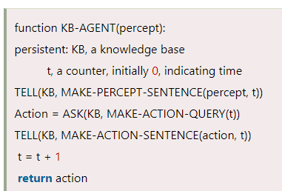
Structure outline of a generic knowledge-based agents

Slide 11
What is knowledge representation?
Humans are best at understanding, reasoning, and interpreting knowledge. Human knows things, which is knowledge and as per their knowledge they perform various actions in the real world. But how machines do all these things comes under knowledge representation and reasoning. Hence we can describe Knowledge representation as following:
Knowledge representation and reasoning (KR, KRR) is the part of Artificial intelligence which concerned with AI agents thinking and how thinking contributes to intelligent behavior of agents.

Slide 12
What to Represent:
Following are the kind of knowledge which needs to be represented in AI systems:
Object: All the facts about objects in our world domain. E.g., Guitars contains strings, trumpets are brass instruments.
Events: Events are the actions which occur in our world.
Performance: It describe behavior which involves knowledge about how to do things.
Meta-knowledge: It is knowledge about what we know.
Facts: Facts are the truths about the real world and what we represent.
Knowledge-Base: The central component of the knowledge-based agents is the knowledge base. It is represented as KB. The Knowledgebase is a group of the Sentences (Here, sentences are used as a technical term and not identical with the English language).

Slide 13
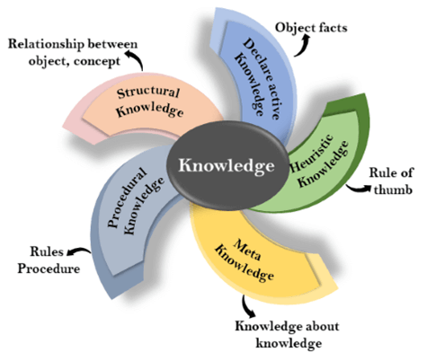
Types of knowledge

Slide 14
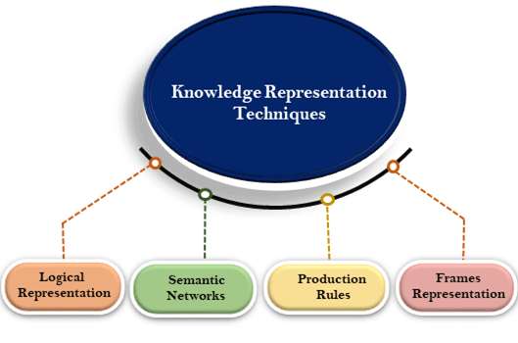
Techniques of knowledge representation There are mainly four ways of knowledge representation which are given as follows:
  Logical Representation
  Semantic Network Representation
  Frame Representation
  Production Rules

Slide 15
Problem Solving
Different types of problem-solving agent defined and use at an atomic level without any internal state visible with a problem-solving algorithm.
The problem-solving agent performs precisely by defining problems and several solutions.
So we can say that problem solving is a part of artificial intelligence that encompasses a number of techniques such as a tree, B-tree, heuristic algorithms to solve a problem.

Slide 16
Steps problem-solving in AI: The problem of AI is directly associated with the nature of humans and their activities. So we need a number of finite steps to solve a problem which makes human easy works.
These are the following steps which require to solve a problem :

Slide 17
Goal Formulation: This one is the first and simple step in problem-solving. It organizes finite steps to formulate a target/goals which require some action to achieve the goal. Today the formulation of the goal is based on AI agents.
Problem formulation: It is one of the core steps of problem-solving which decides what action should be taken to achieve the formulated goal. In AI this core part is dependent upon software agent which consisted of the following components to formulate the associated problem.

Slide 18
Components to formulate the associated problem:
Initial State: This state requires an initial state for the problem which starts the AI agent towards a specified goal. In this state new methods also initialize problem domain solving by a specific class.
Action: This stage of problem formulation works with function with a specific class taken from the initial state and all possible actions done in this stage.
Transition: This stage of problem formulation integrates the actual action done by the previous action stage and collects the final stage to forward it to their next stage.

Slide 19
Goal test: This stage determines that the specified goal achieved by the integrated transition model or not, whenever the goal achieves stop the action and forward into the next stage to determines the cost to achieve the goal.
Path costing: This component of problem-solving numerical assigned what will be the cost to achieve the goal. It requires all hardware software and human working cost.

Slide 20
Search Algorithms in AI
Artificial Intelligence is the study of building agents that act rationally. Most of the time, these agents perform some kind of search algorithm in the background in order to achieve their tasks.
A search problem consists of:
  A State Space. Set of all possible states where you can be.
  A Start State. The state from where the search begins.
  A Goal Test. A function that looks at the current state returns whether or not it is the goal state.
The Solution to a search problem is a sequence of actions, called the plan that transforms the start state to the goal state.
This plan is achieved through search algorithms.

Slide 21
Types of search algorithms:
There are far too many powerful search algorithms out there to fit in a single article. Instead, this article will discuss six of the fundamental search algorithms, divided into two categories, as shown below.

Slide 22

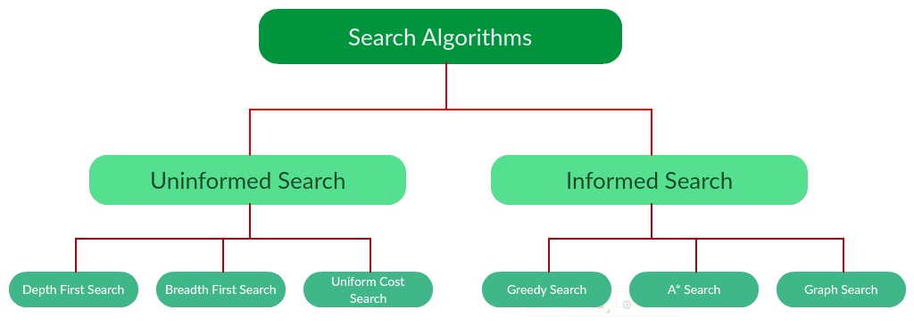

Slide 23
Heuristic Search
Heuristic is a function which is used in Informed Search, and it finds the most promising path.
It takes the current state of the agent as its input and produces the estimation of how close agent is from the goal.

Slide 24
The heuristic method, however, might not always give the best solution, but it guaranteed to find a good solution in reasonable time.
Heuristic function estimates how close a state is to the goal. It is represented by h(n), and it calculates the cost of an optimal path between the pair of states.
The value of the heuristic function is always positive.

Slide 25
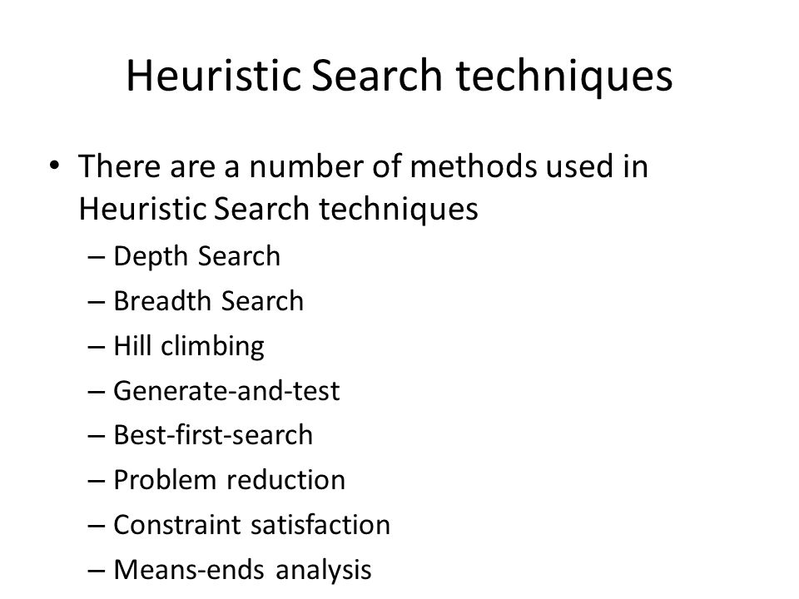

Slide 26
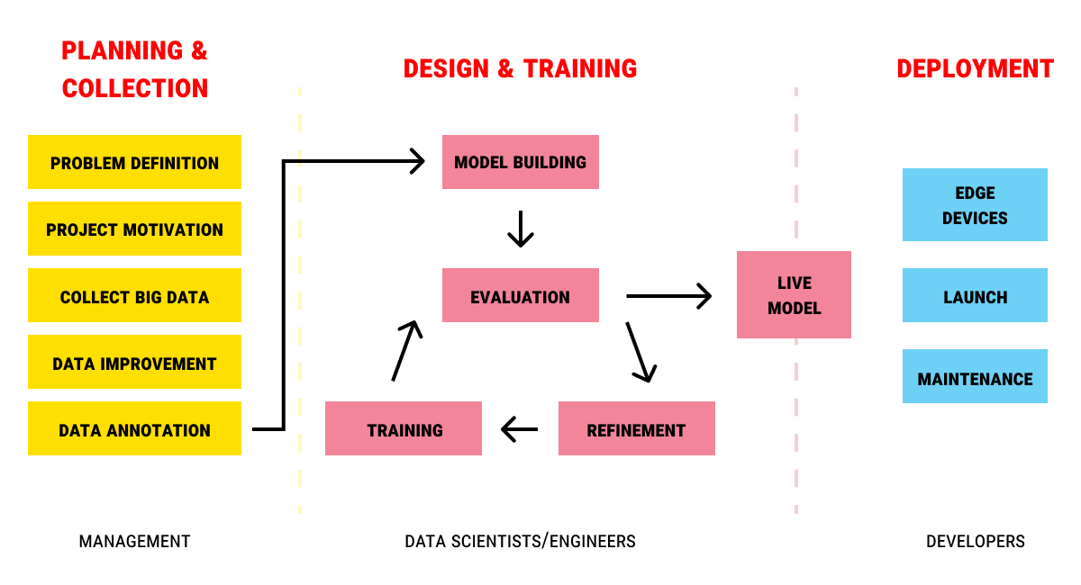
Phases of AI Project Cycle

Slide 27
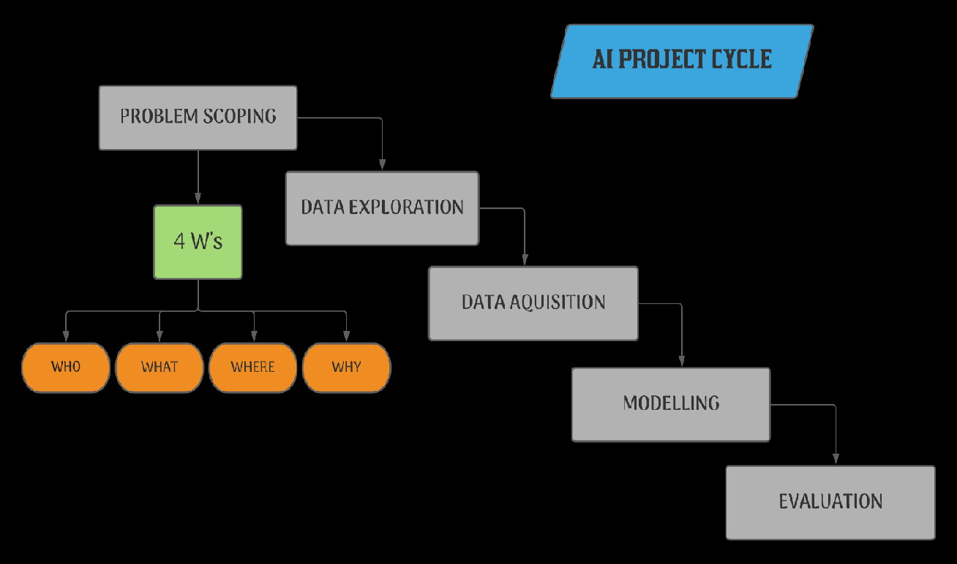

Slide 28
Problem Scoping
Problem Scoping is the first stage of the AI project cycle. In this stage of AI development, problems will be identified. It is then followed by designing, developing, or building, and finally testing the project.
The problem scoping refers to the identification of a problem and the vision to solve it.

Slide 29
The 4Ws of Problem Scoping
  Who? – Refers that who is facing a problem and who are the stakeholders of the problem
  What? – Refers to what is the problem and how you know about the problem
  Where? – It is related to the context or situation or location of the problem
  Why? – Refers to why we need to solve the problem and what are the benefits to the stakeholders after solving the problem

Slide 30
Data Acquisition
In an AI project lifecycle, data acquisition is understood as gathering, filtering, and cleaning data before the data is stored in a data storage system.
Data acquisition is generally governed by four Vs – volume, velocity, variety, and value. In most cases, we assume high-value, high-velocity, high-variety, but low-value data, which makes it critical to have adaptable and time-efficient gathering, filtering, and cleaning algorithms.

Slide 31
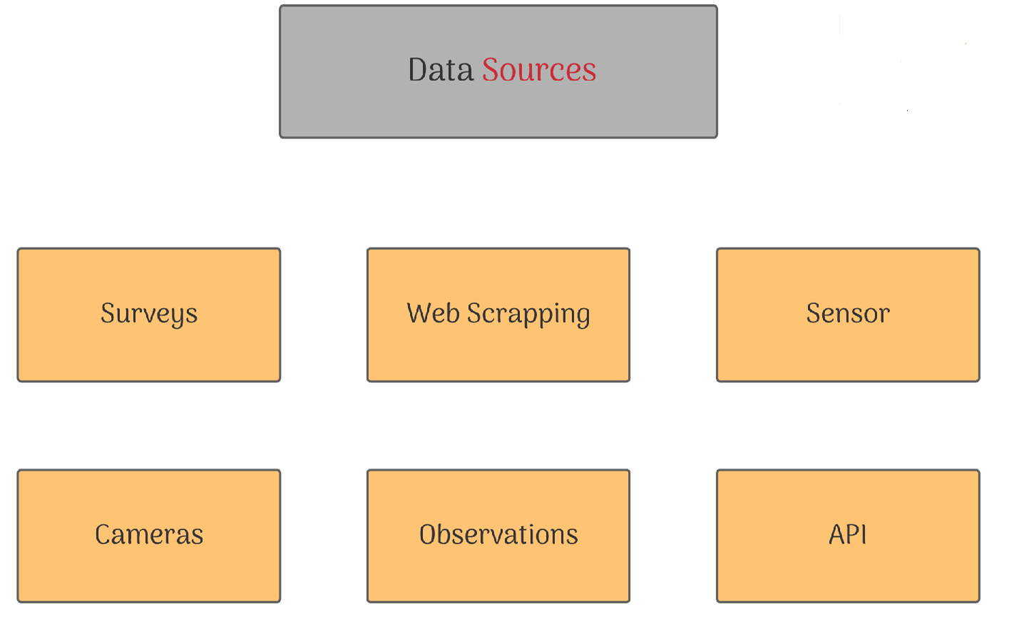

Slide 32
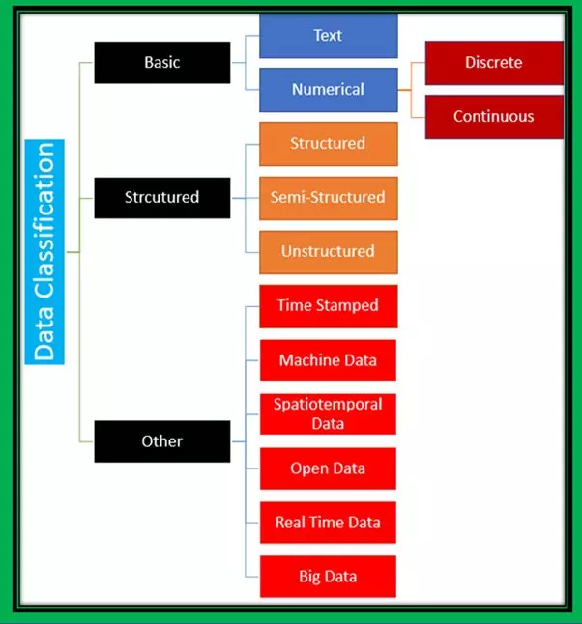
Data Acquisition

Slide 33
It ensures only high-value fragments of the data are actually processed by the data processing system.
Basically, we can classify data into two categories – numeric data and text data.
Numeric data is mainly used for computation and can be further classified into discrete data and continuous data.
Discrete data only contains integer numeric data, and it doesn’t have any decimal or fractional value. Continuous data represents data with any range. It can have decimal or fractional values.

Slide 34
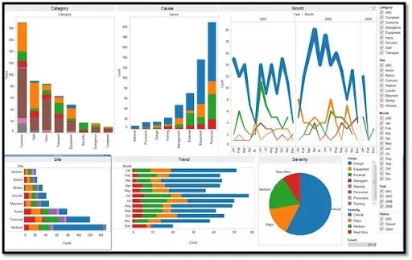
Data Exploration in AI Project Cycle

Slide 35
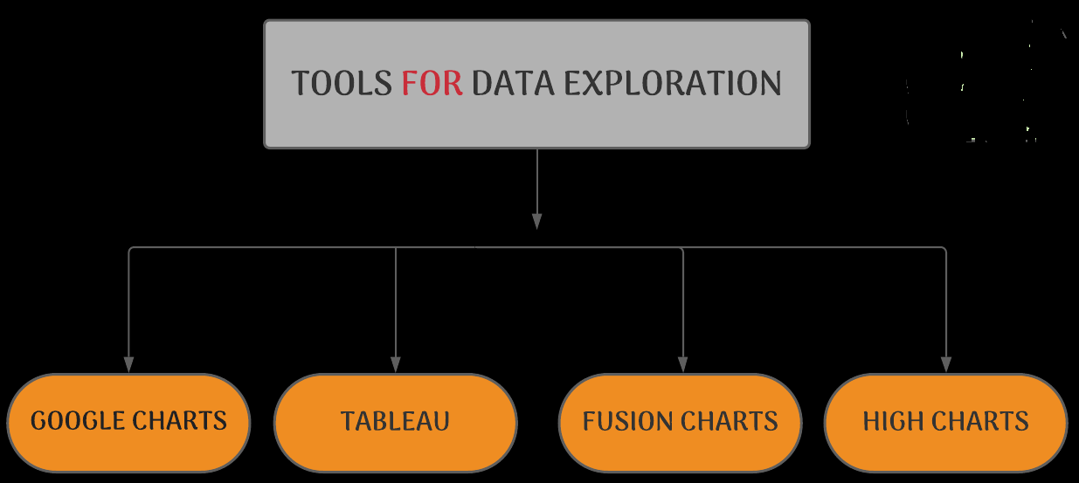

Slide 36
Data exploration is the process of analysing a data set to get initial patterns, characteristics, and points of interest.
It is the first step of data analysis, after data acquisition, to explore and visualize data to uncover insights from the raw data.
Data exploration is generally done by using a combination of automated tools and techniques.

Slide 37
MODELING
The Design phase is essentially an iterative process comprising all the steps relevant to building the AI or machine learning model: data acquisition, exploration, preparation, cleaning, feature engineering, testing and running a set of models to try to predict behaviors or discover insights in the data.

Slide 38
Models
There are 2 ways/Approaches
Learning Based Approach
Rule Based Approach

Slide 39
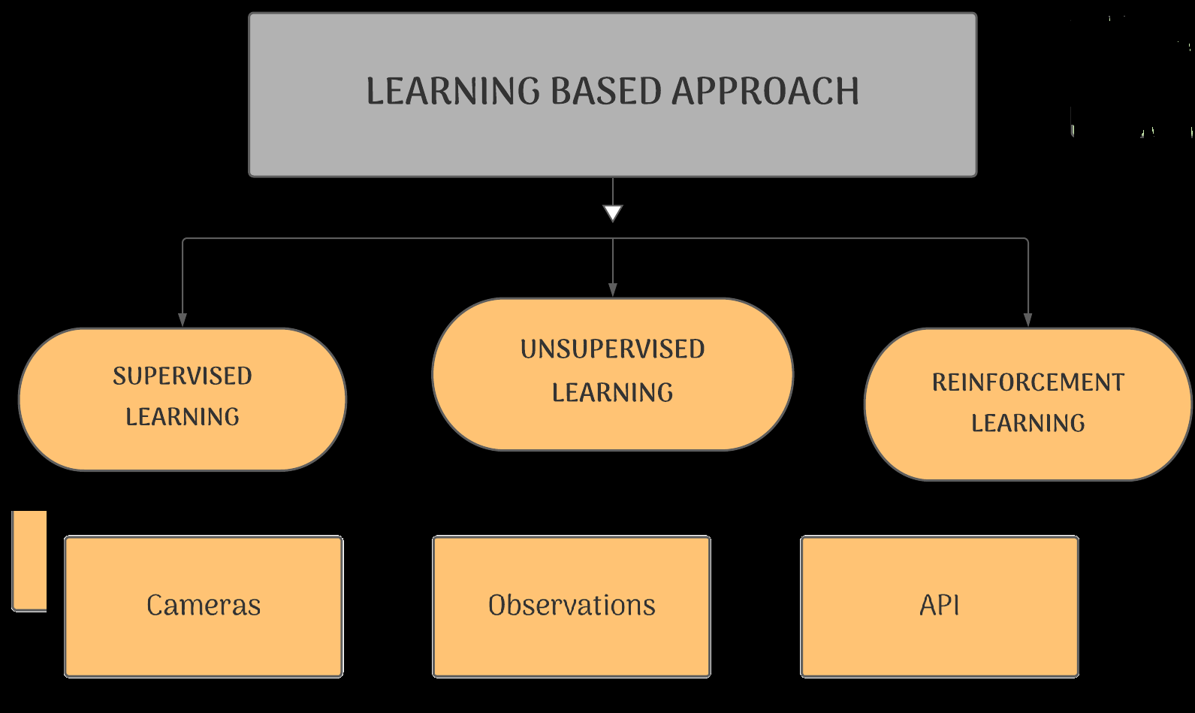

Slide 40
Rule Based Approach
Rule Based Approach Refers to the AI modelling where the relationship or patterns in data are defined by the developer.
That means the machine works on the rules and information given by the developer and performs the task accordingly.

